Slide 1
SQL CAPSTONE PROJECT of Amazon Data Analysis
Presented By:
Jadhav Yogesh,
S104477.

Slide 2
Aim: The Major aim of the project is to gain insights into the sales data of Amazon to understand the different factors that affect sales of different branches.
About Data:
This dataset contains sales transactions from three different branches of Amazon, respectively located in Mandalay, Yangon and Naypyitaw. The data contains 17 columns and 1000 rows
Approach Used:
Data Wrangling-Make sure data set do not have any null values, then build the database and create table and insert the data by selecting NOT NULL as field for each column
Feature Engineering- added new columns(timeofday, dayname, monthname) with existing columns
Exploratory Data Analysis: EDA is done to answer list of business questions and get business insights.

Slide 3
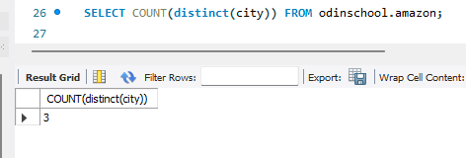
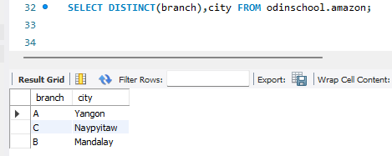
Business Questions:
What is the count of distinct cities in the dataset?
2. For each branch, what is the corresponding city?

Slide 4
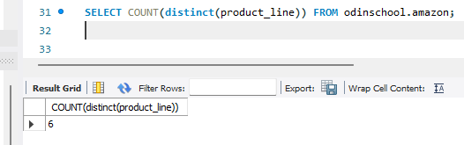
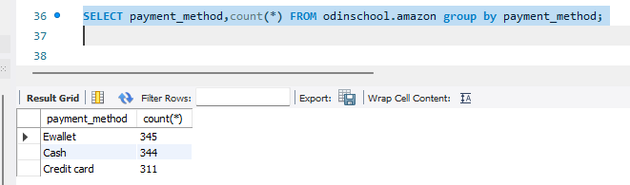
3. What is the count of distinct product lines in the dataset?
4. Which payment method occurs most frequently?

Slide 5
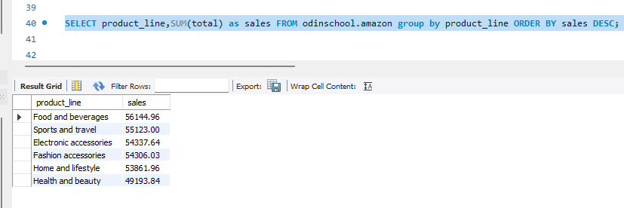
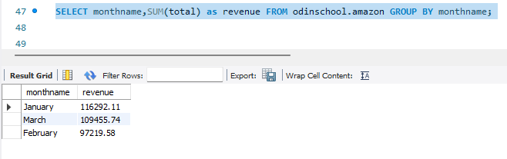
5. Which product line has the highest sales?
6. How much revenue is generated each month?

Slide 6
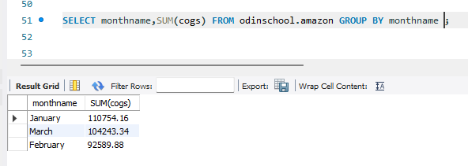
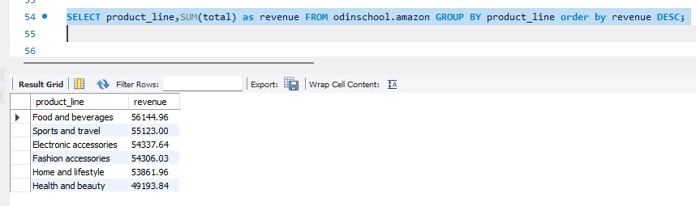
7.In which month did the cost of goods sold reach its peak?
8. Which product line generated the highest revenue?

Slide 7
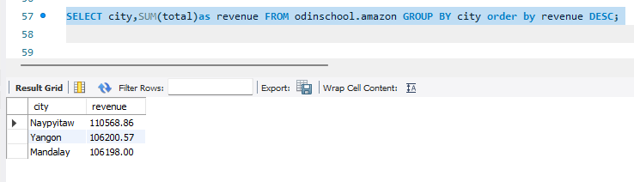
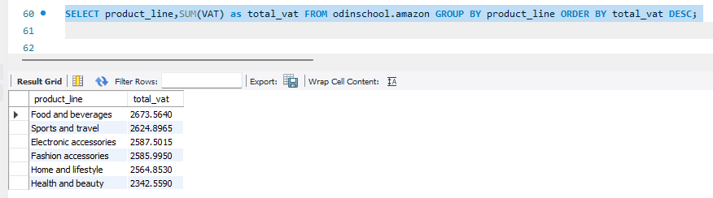
9. In which city was the highest revenue recorded?
10. Which product line incurred the highest Value Added Tax?

Slide 8
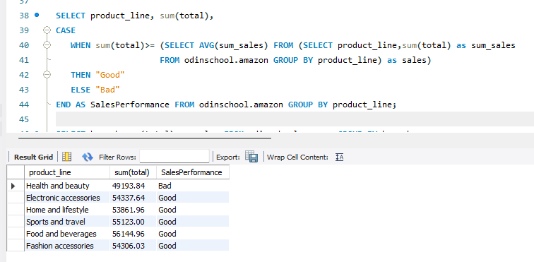
11. For each product line, add a column indicating "Good" if its sales are above average, otherwise "Bad."

Slide 9
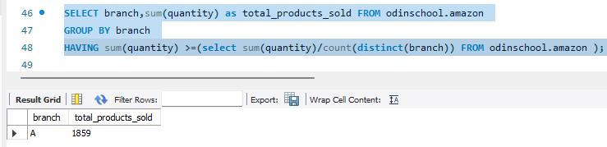
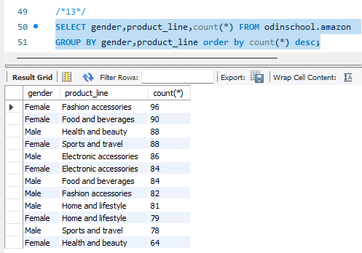
12. Identify the branch that exceeded the average number of products sold.
13.Which product line is most frequently associated with each gender?

Slide 10
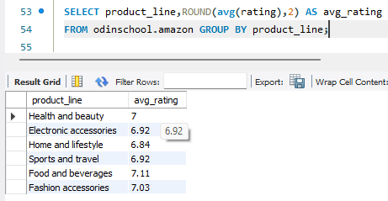
14.Calculate the average rating for each product line.

Slide 11
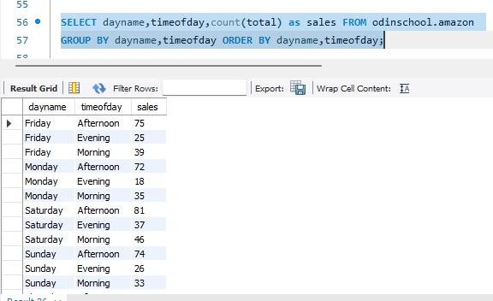
15. Count the sales occurrences for each time of day on every weekday.

Slide 12
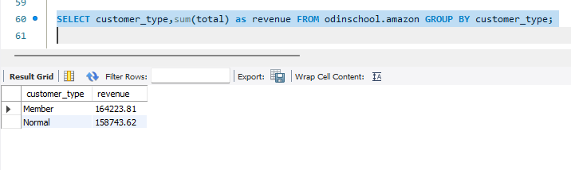
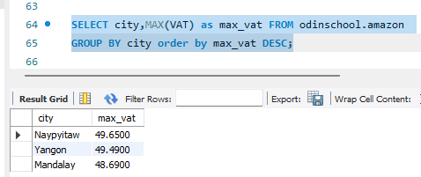
16. Identify the customer type contributing the highest revenue.
17. Determine the city with the highest VAT percentage.

Slide 13
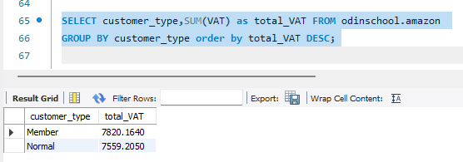
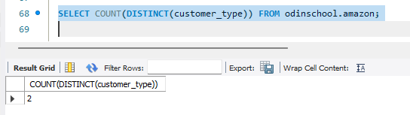
18. Identify the customer type with the highest VAT payments
19. What is the count of distinct customer types in the dataset?

Slide 14
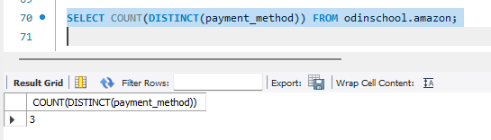
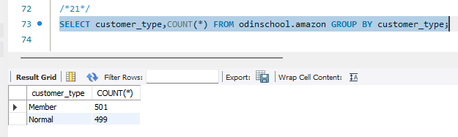
20. What is the count of distinct payment methods in the dataset?
21. Which customer type occurs most frequently?

Slide 15
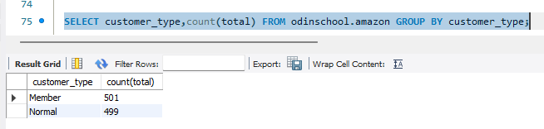
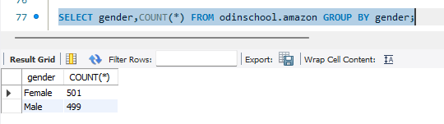
22. Identify the customer type with the highest purchase frequency.
23. Determine the predominant gender among customers.

Slide 16
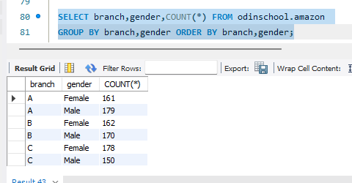
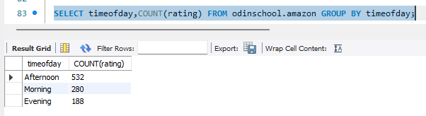
24. Examine the distribution of genders within each branch.
25. Identify the time of day when customers provide the most ratings.

Slide 17
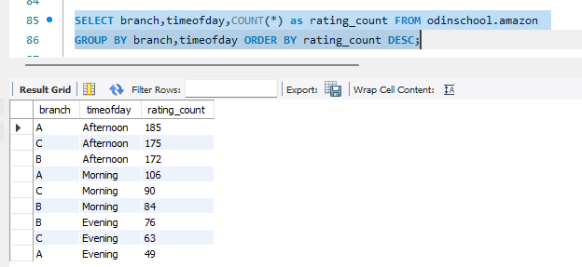
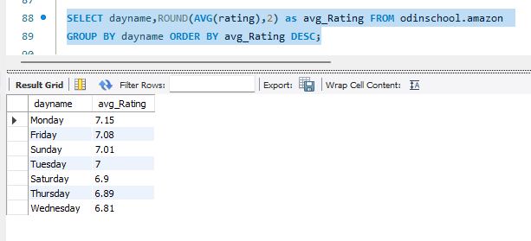
26. Determine the time of day with the highest customer ratings for each branch.
27. Identify the day of the week with the highest average ratings.

Slide 18
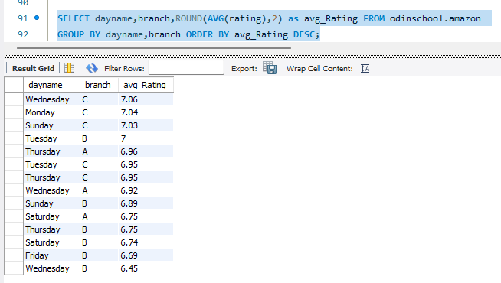
28. Determine the day of the week with the highest average ratings for each branch

Slide 19
Analysis List: 1.Product Analysis: Top Performers: Fashion Accessories, Food and beverages performed Well Under Performers: Home and Styles, Health and Beauty less performed compared to others. Food and beverages have highest average rating and contribute high VAT compare to other products.
2.Sales Analysis:
In Naypyitaw City Highest Revenue Recorded.
Ewallet payment method occurs most frequently compare to other
January (116292.11’) Month Reported Highest Revenue.
In afternoon session most sales occur and also most of the people give rating specially on Mondays.

Slide 20
3.Customer Analysis: Males are more spending on Health and beauty, Electronic accessories but rating of those product lines are less, we have to increase quality. Female are more spending on Food and beverages, Fashion accessories, rating also high for these Product line. Member customer type have the highest VAT payments.

